Slide 1
Logistic Regression

Slide 2
Logistic Regression – a few points
Logistic Regression is also very popular for establishing a baseline
Here are a few of the traits that make it popular:
Like Naïve Bayes, Logistic Regression is very fast
It’s highly interpretable
Doesn’t require features to be scaled
Doesn’t require any tuning
Easy to regularize
Outputs predicted probabilities

Slide 3
Logistic Regression – a few points
Although Logistic Regression is popular, it is often misunderstood.
Here are a few common questions that people have when they think of logistic regression:
Why is it called “logistic regression” if it’s used for classification?
Why is it called a linear model?
How do you interpret the model coefficients?

Slide 4
Probability Reminder
Probability

Slide 5
Probability Reminder
Probability
Measure of Likelihood, meaning how likely is something going to happen, how likely is something true

Slide 6
Probability Reminder
Probability
Measure of Likelihood, meaning how likely is something going to happen, how likely is something true
Expressed as a number between 0-1
0 ……………… 1
0……….……… 100%

Slide 7
Probability Reminder
Probability
Measure of Likelihood, meaning how likely is something going to happen, how likely is something true
Expressed as a number between 0-1
0 ……………… 1
0……….……… 100%
Definitely going to happen

Slide 8
Probability Reminder
Probability
Measure of Likelihood, meaning how likely is something going to happen, how likely is something true
Expressed as a number between 0-1
0 ……………… 1
0……….……… 100%
Definitely NOT going to happen

Slide 9
Probability Reminder
Probability
Measure of Likelihood, meaning how likely is something going to happen, how likely is something true
Expressed as a number between 0-1
0 ………5……… 1
0……….5……… 100%
In the case of a binary outcome we have some midpoint where it’s equally probable/likely

Slide 10
ODDS
Probability
Another measure of probability is ODDS

Slide 11
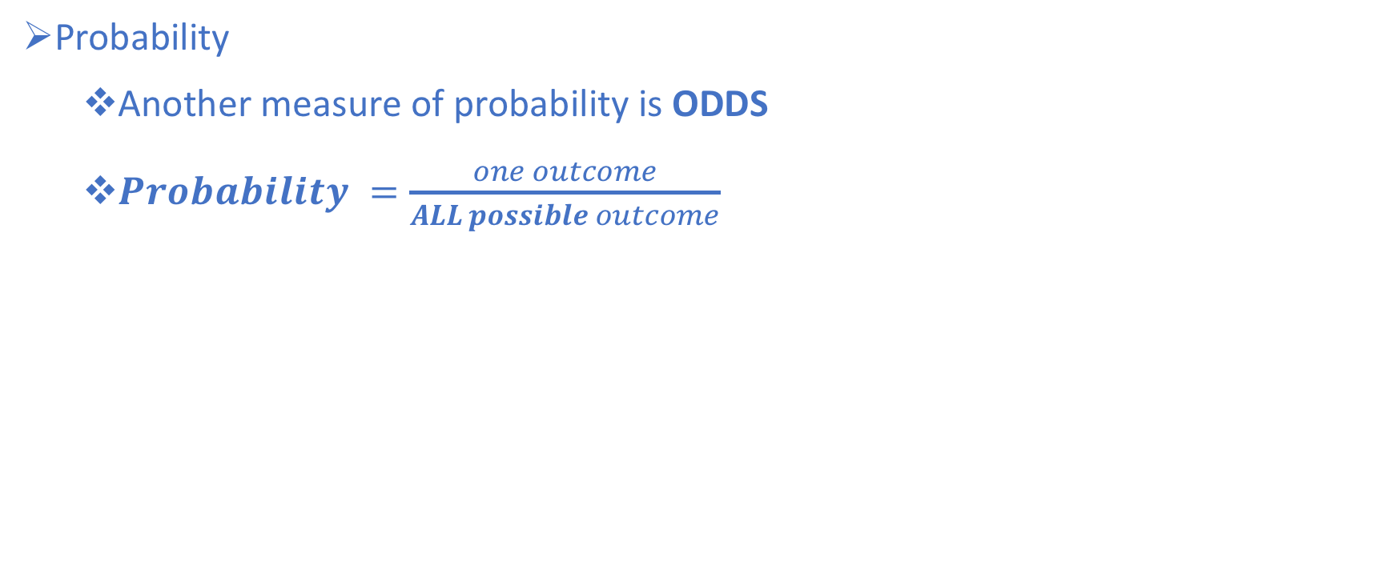
ODDS
Probability
Another measure of probability is ODDS
$Probability =\frac{one outcome}{ALL possible outcome}$

Slide 12
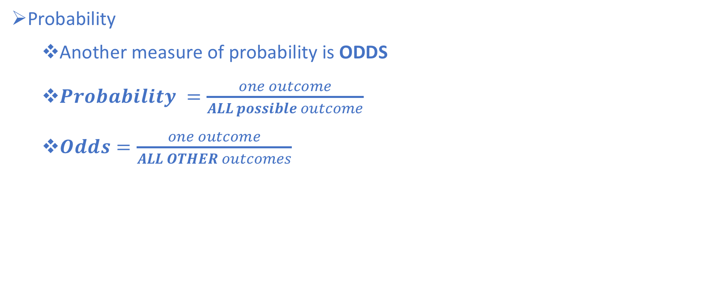
ODDS
Probability
Another measure of probability is ODDS
$Probability =\frac{one outcome}{ALL possible outcome}$
$Odds=\frac{one outcome}{ALL OTHER outcomes}$

Slide 13
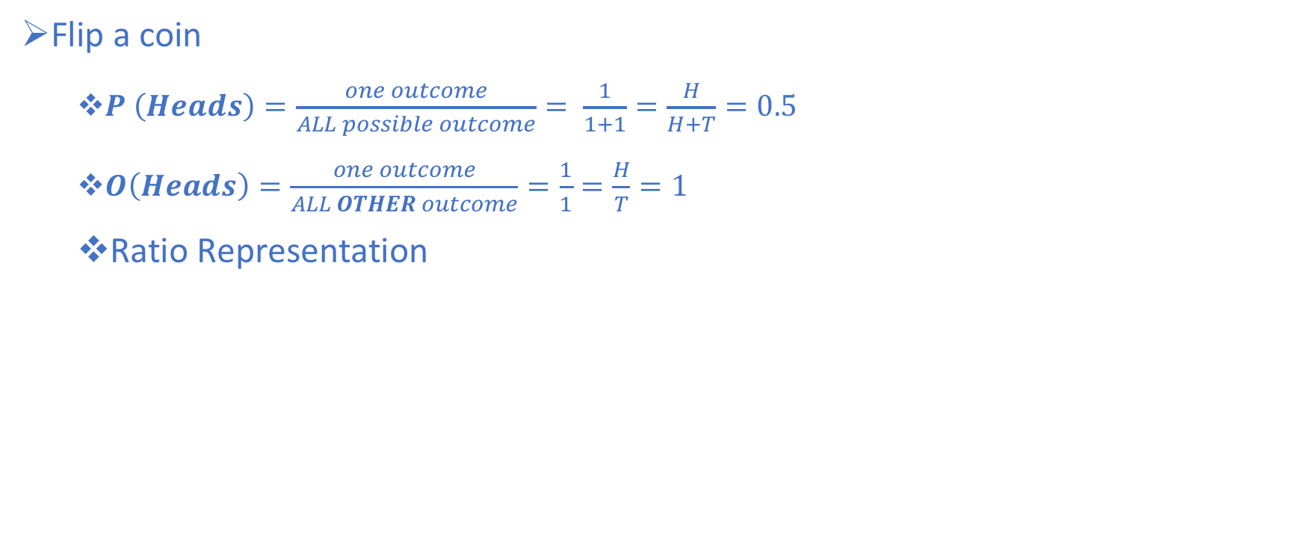
Back to the coinflip
Flip a coin
$P \left(Heads\right)=\frac{one outcome}{ALL possible outcome}= \frac{1}{1+1}=\frac{H}{H+T}=0.5$
$O\left(Heads\right)=\frac{one outcome}{ALL OTHER outcome}=\frac{1}{1}=\frac{H}{T}=1$
Ratio Representation

Slide 14
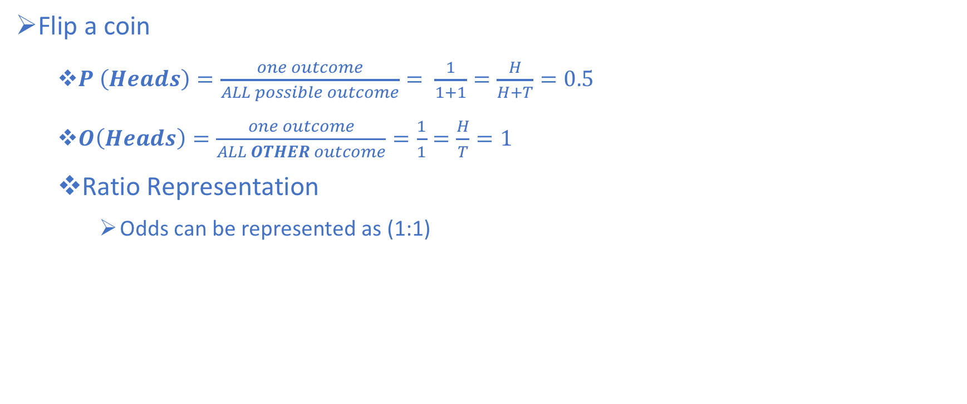
Back to the coinflip
Flip a coin
$P \left(Heads\right)=\frac{one outcome}{ALL possible outcome}= \frac{1}{1+1}=\frac{H}{H+T}=0.5$
$O\left(Heads\right)=\frac{one outcome}{ALL OTHER outcome}=\frac{1}{1}=\frac{H}{T}=1$
Ratio Representation
Odds can be represented as (1:1)

Slide 15
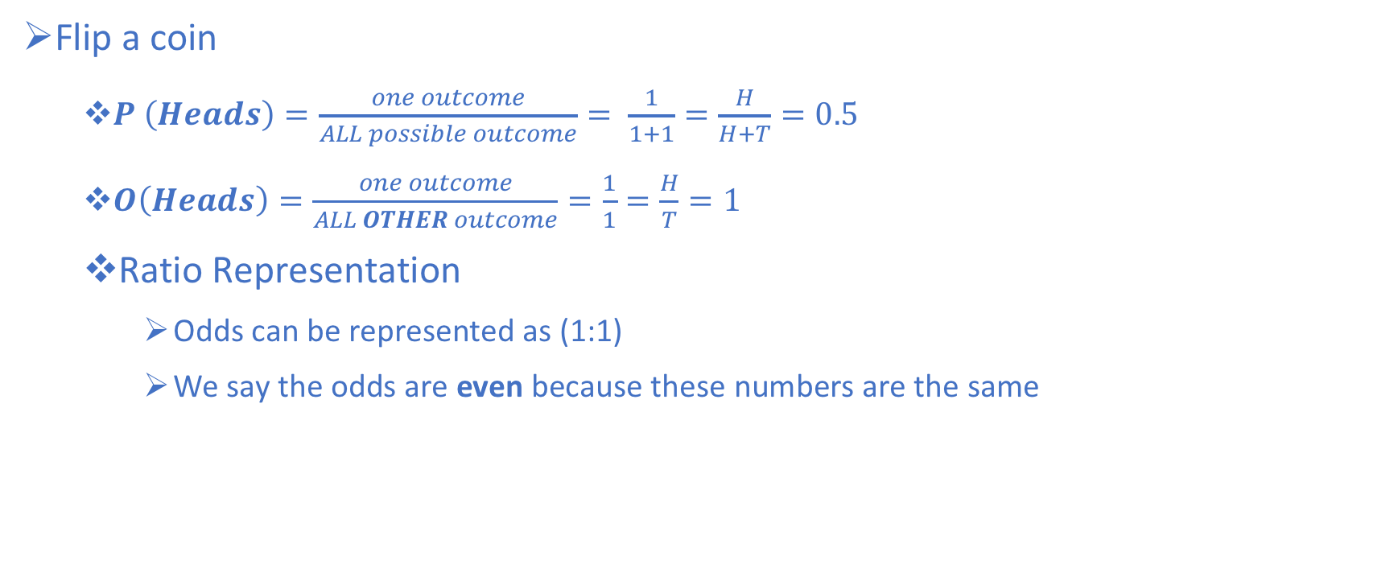
Back to the coinflip
Flip a coin
$P \left(Heads\right)=\frac{one outcome}{ALL possible outcome}= \frac{1}{1+1}=\frac{H}{H+T}=0.5$
$O\left(Heads\right)=\frac{one outcome}{ALL OTHER outcome}=\frac{1}{1}=\frac{H}{T}=1$
Ratio Representation
Odds can be represented as (1:1)
We say the odds are even because these numbers are the same

Slide 16
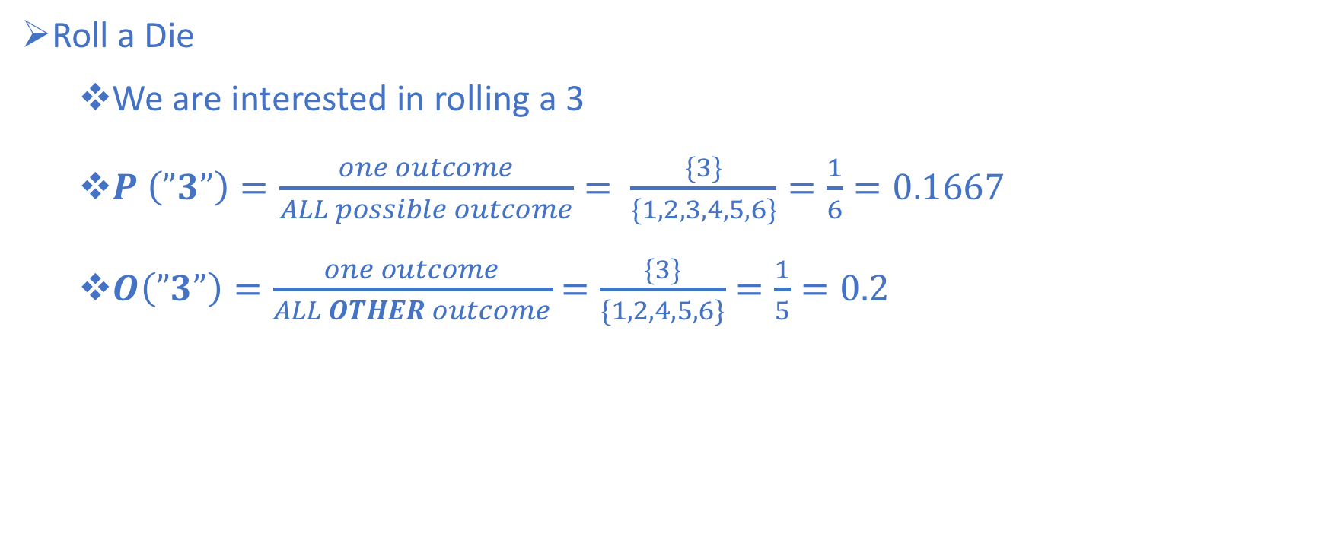
Rolling a Die
Roll a Die
We are interested in rolling a 3
$P \left(”3”\right)=\frac{one outcome}{ALL possible outcome}= \frac{\{3\}}{\{1,2,3,4,5,6\}}=\frac{1}{6}=0.1667$
$O\left(”3”\right)=\frac{one outcome}{ALL OTHER outcome}=\frac{\{3\}}{\{1,2,4,5,6\}}=\frac{1}{5}=0.2$

Slide 17
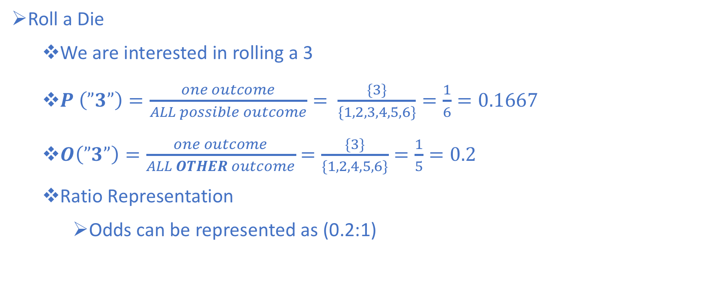
Rolling a Die
Roll a Die
We are interested in rolling a 3
$P \left(”3”\right)=\frac{one outcome}{ALL possible outcome}= \frac{\{3\}}{\{1,2,3,4,5,6\}}=\frac{1}{6}=0.1667$
$O\left(”3”\right)=\frac{one outcome}{ALL OTHER outcome}=\frac{\{3\}}{\{1,2,4,5,6\}}=\frac{1}{5}=0.2$
Ratio Representation
Odds can be represented as (0.2:1)

Slide 18
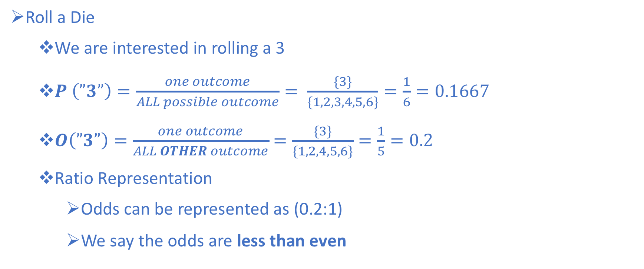
Rolling a Die
Roll a Die
We are interested in rolling a 3
$P \left(”3”\right)=\frac{one outcome}{ALL possible outcome}= \frac{\{3\}}{\{1,2,3,4,5,6\}}=\frac{1}{6}=0.1667$
$O\left(”3”\right)=\frac{one outcome}{ALL OTHER outcome}=\frac{\{3\}}{\{1,2,4,5,6\}}=\frac{1}{5}=0.2$
Ratio Representation
Odds can be represented as (0.2:1)
We say the odds are less than even

Slide 19
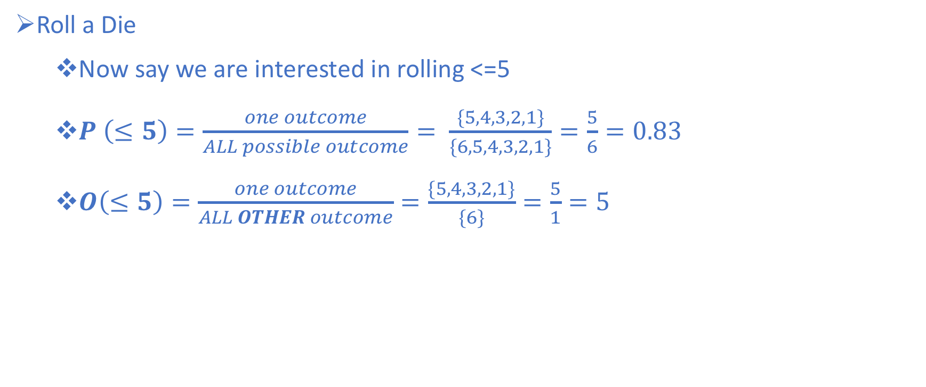
Rolling a Die
Roll a Die
Now say we are interested in rolling <=5
$P \left(≤5\right)=\frac{one outcome}{ALL possible outcome}= \frac{\{5,4,3,2,1\}}{\{6,5,4,3,2,1\}}=\frac{5}{6}=0.83$
$O\left(≤5\right)=\frac{one outcome}{ALL OTHER outcome}=\frac{\{5,4,3,2,1\}}{\{6\}}=\frac{5}{1}=5$

Slide 20
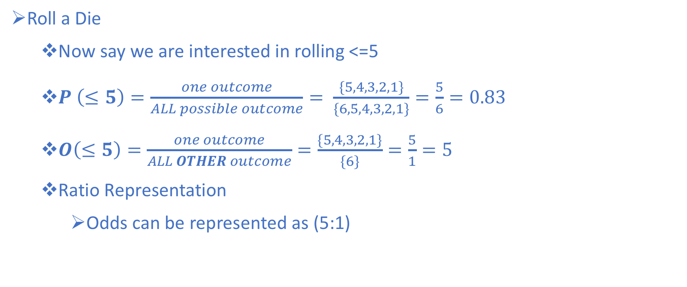
Rolling a Die
Roll a Die
Now say we are interested in rolling <=5
$P \left(≤5\right)=\frac{one outcome}{ALL possible outcome}= \frac{\{5,4,3,2,1\}}{\{6,5,4,3,2,1\}}=\frac{5}{6}=0.83$
$O\left(≤5\right)=\frac{one outcome}{ALL OTHER outcome}=\frac{\{5,4,3,2,1\}}{\{6\}}=\frac{5}{1}=5$
Ratio Representation
Odds can be represented as (5:1)

Slide 21
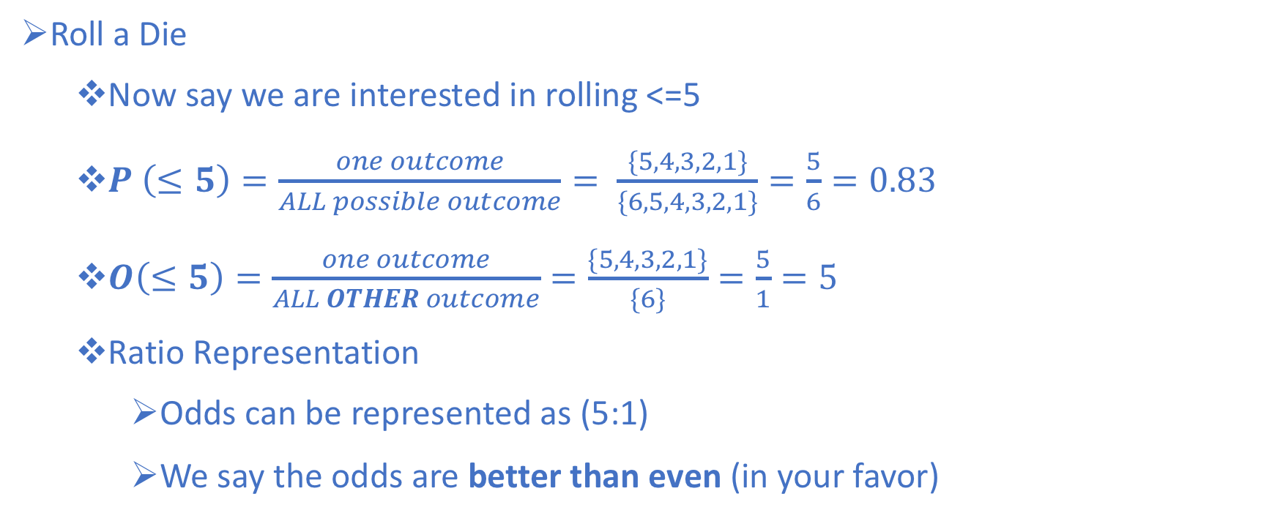
Rolling a Die
Roll a Die
Now say we are interested in rolling <=5
$P \left(≤5\right)=\frac{one outcome}{ALL possible outcome}= \frac{\{5,4,3,2,1\}}{\{6,5,4,3,2,1\}}=\frac{5}{6}=0.83$
$O\left(≤5\right)=\frac{one outcome}{ALL OTHER outcome}=\frac{\{5,4,3,2,1\}}{\{6\}}=\frac{5}{1}=5$
Ratio Representation
Odds can be represented as (5:1)
We say the odds are better than even (in your favor)

Slide 22
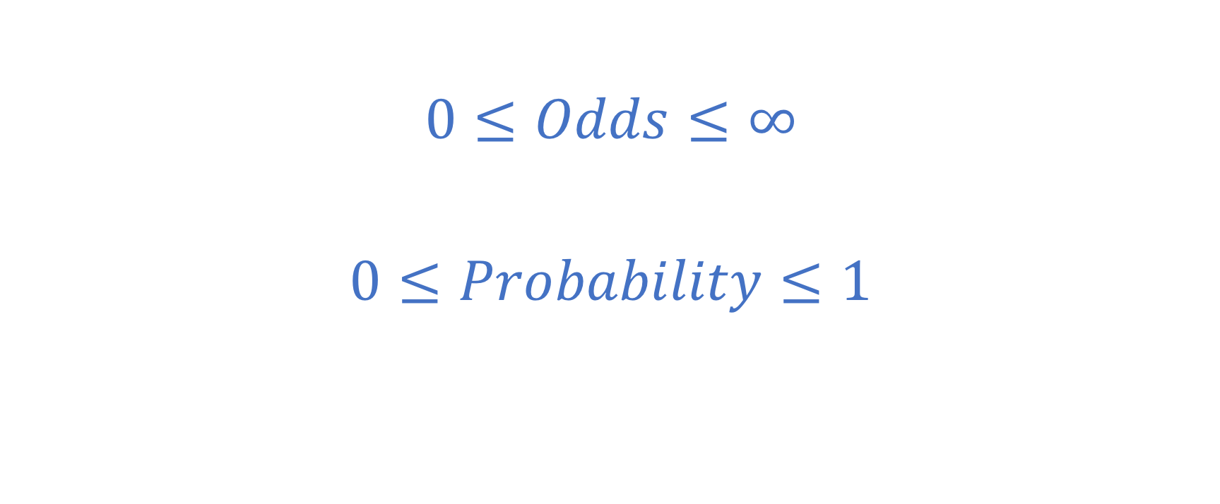
Ranges for Odds and Probability
$$0≤Odds≤∞$$
$$0≤Probability≤1$$

Slide 23
Odds Ratio Example
Smokers, non-smokers study
Interested in studying smoking/lung cancer, 2 groups
Group 1 (Case Group) – Have lung cancer
8 Smokers
2 Non-smokers
Group 2 (Control Group) – Don’t have lung cancer
4 Smokers
6 Non-smokers

Slide 24
Odds Ratio Example
Smokers, non-smokers study
Interested in studying smoking/lung cancer, 2 groups
Group 1 (Case Group) – Have lung cancer
8 Smokers
2 Non-smokers
Group 2 (Control Group) – Don’t have lung cancer
4 Smokers
6 Non-smokers
 | Case | Control
Smokers | 8 | 4
Non-Smokers | 2 | 6

Slide 25

Odds Ratio Example
Smokers, non-smokers study
Interested in studying smoking/lung cancer, 2 groups
Group 1 (Case Group) – Have lung cancer
8 Smokers
2 Non-smokers
Group 2 (Control Group) – Don’t have lung cancer
4 Smokers
6 Non-smokers
 | Case | Control
Smokers | 8 | 4
Non-Smokers | 2 | 6
$$Odds of Smoking,Case Group=\frac{8}{2}=4$$

Slide 26
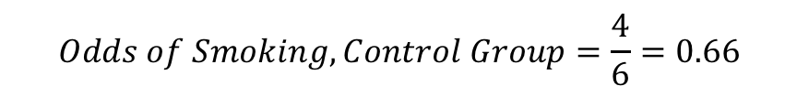
Odds Ratio Example
Smokers, non-smokers study
Interested in studying smoking/lung cancer, 2 groups
Group 1 (Case Group) – Have lung cancer
8 Smokers
2 Non-smokers
Group 2 (Control Group) – Don’t have lung cancer
4 Smokers
6 Non-smokers
 | Case | Control
Smokers | 8 | 4
Non-Smokers | 2 | 6
$$Odds of Smoking,Case Group=\frac{8}{2}=4$$
$$Odds of Smoking,Control Group=\frac{4}{6}=0.66$$

Slide 27
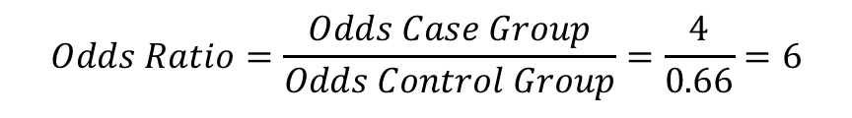
Odds Ratio Example
Smokers, non-smokers study
Interested in studying smoking/lung cancer, 2 groups
Group 1 (Case Group) – Have lung cancer
8 Smokers
2 Non-smokers
Group 2 (Control Group) – Don’t have lung cancer
4 Smokers
6 Non-smokers
 | Case | Control
Smokers | 8 | 4
Non-Smokers | 2 | 6
$$Odds of Smoking,Case Group=\frac{8}{2}=4$$
$$Odds of Smoking,Control Group=\frac{4}{6}=0.66$$
$$Odds Ratio=\frac{Odds Case Group}{Odds Control Group}=\frac{4}{0.66}=6$$

Slide 28
Odds Ratio Example
Smokers, non-smokers study
Interested in studying smoking/lung cancer, 2 groups
Group 1 (Case Group) – Have lung cancer
8 Smokers
2 Non-smokers
Group 2 (Control Group) – Don’t have lung cancer
4 Smokers
6 Non-smokers
How can we compare the odds?
 | Case | Control
Smokers | 8 | 4
Non-Smokers | 2 | 6
$$Odds of Smoking,Case Group=\frac{8}{2}=4$$
$$Odds of Smoking,Control Group=\frac{4}{6}=0.66$$
$$Odds Ratio=\frac{Odds Case Group}{Odds Control Group}=\frac{4}{0.66}=6$$

Slide 29
Odds Ratio Example
Smokers, non-smokers study
Interested in studying smoking/lung cancer, 2 groups
Group 1 (Case Group) – Have lung cancer
8 Smokers
2 Non-smokers
Group 2 (Control Group) – Don’t have lung cancer
4 Smokers
6 Non-smokers
How can we compare the odds?
Conclusion:
The Case group was 6 times more likely to be a smoker
Making no claims about causation
Simply that people who have lung cancer are 6 times more likely to have smoked
 | Case | Control
Smokers | 8 | 4
Non-Smokers | 2 | 6
$$Odds of Smoking,Case Group=\frac{8}{2}=4$$
$$Odds of Smoking,Control Group=\frac{4}{6}=0.66$$
$$Odds Ratio=\frac{Odds Case Group}{Odds Control Group}=\frac{4}{0.66}=6$$

Slide 30
$$e$$
From Wikipedia:
“The natural logarithm, formerly known as the hyperbolic logarithm, is the logarithm to the base e, where e is an irrational constant approximately equal to 2.718281828459.”

Slide 31
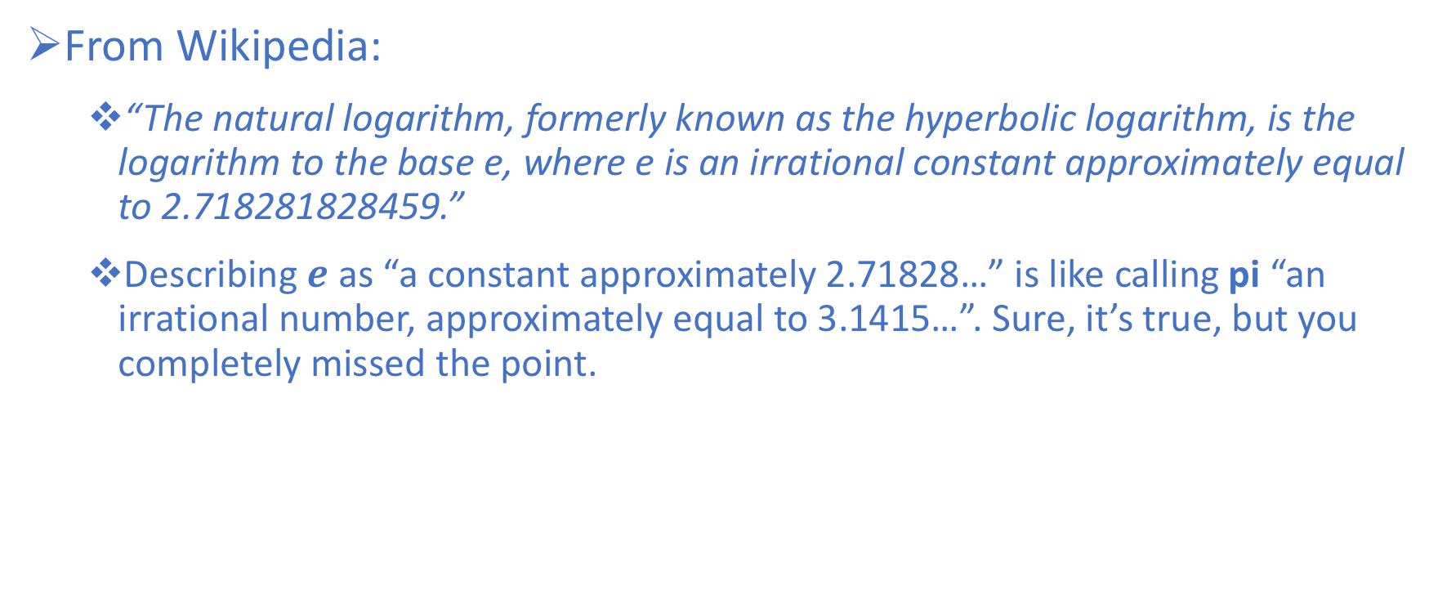
$$e$$
From Wikipedia:
“The natural logarithm, formerly known as the hyperbolic logarithm, is the logarithm to the base e, where e is an irrational constant approximately equal to 2.718281828459.”
Describing $e$as “a constant approximately 2.71828…” is like calling pi “an irrational number, approximately equal to 3.1415…”. Sure, it’s true, but you completely missed the point.

Slide 32
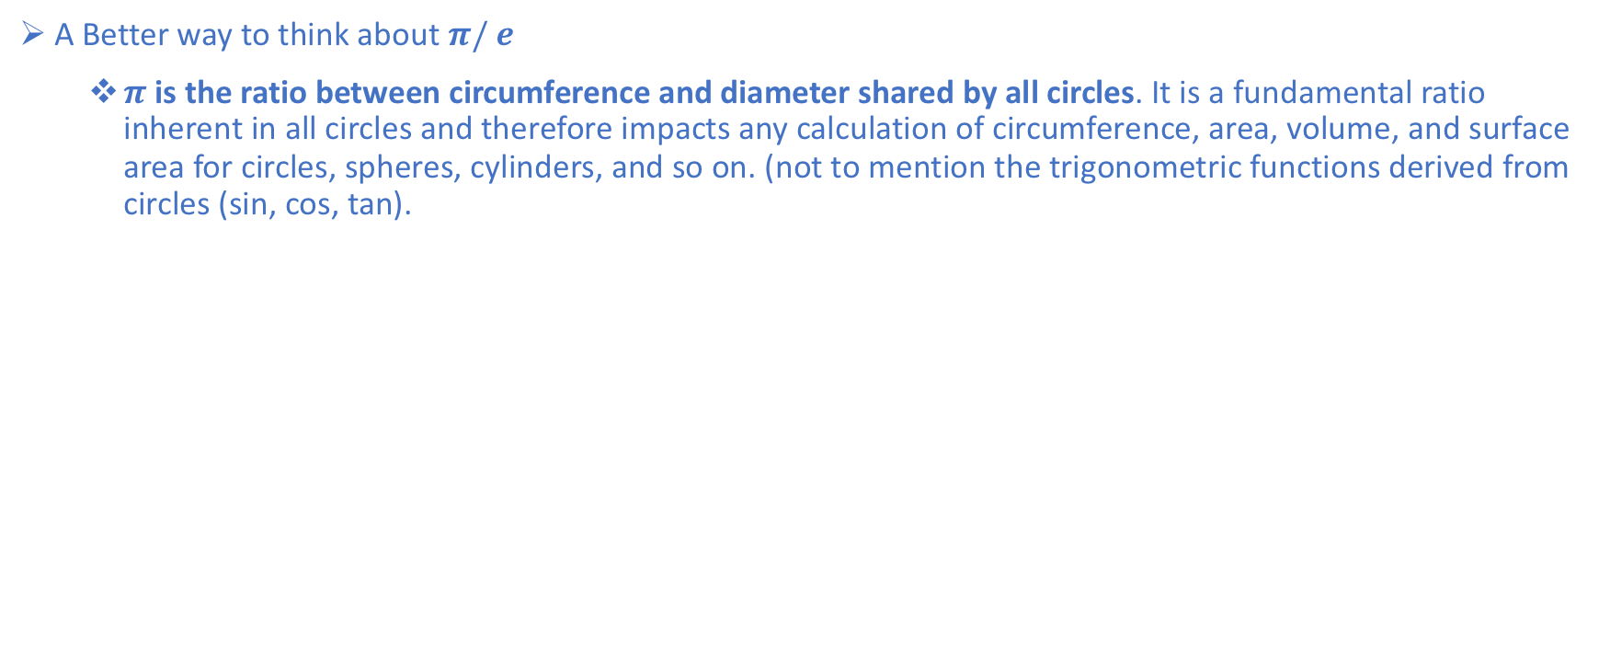
$$e$$
A Better way to think about $π/ e$
$π$ is the ratio between circumference and diameter shared by all circles. It is a fundamental ratio inherent in all circles and therefore impacts any calculation of circumference, area, volume, and surface area for circles, spheres, cylinders, and so on. (not to mention the trigonometric functions derived from circles (sin, cos, tan).

Slide 33
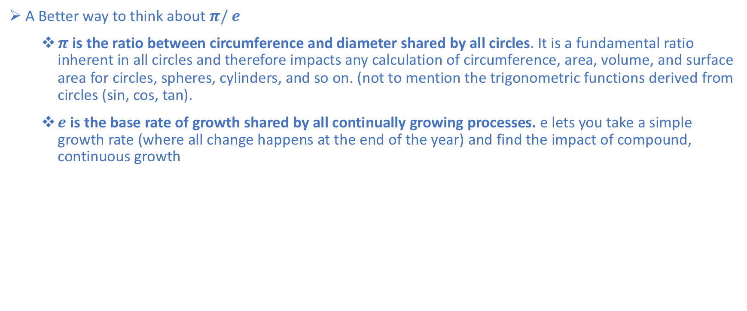
$$e$$
A Better way to think about $π/ e$
$π$ is the ratio between circumference and diameter shared by all circles. It is a fundamental ratio inherent in all circles and therefore impacts any calculation of circumference, area, volume, and surface area for circles, spheres, cylinders, and so on. (not to mention the trigonometric functions derived from circles (sin, cos, tan).
$e$ is the base rate of growth shared by all continually growing processes. e lets you take a simple growth rate (where all change happens at the end of the year) and find the impact of compound, continuous growth

Slide 34
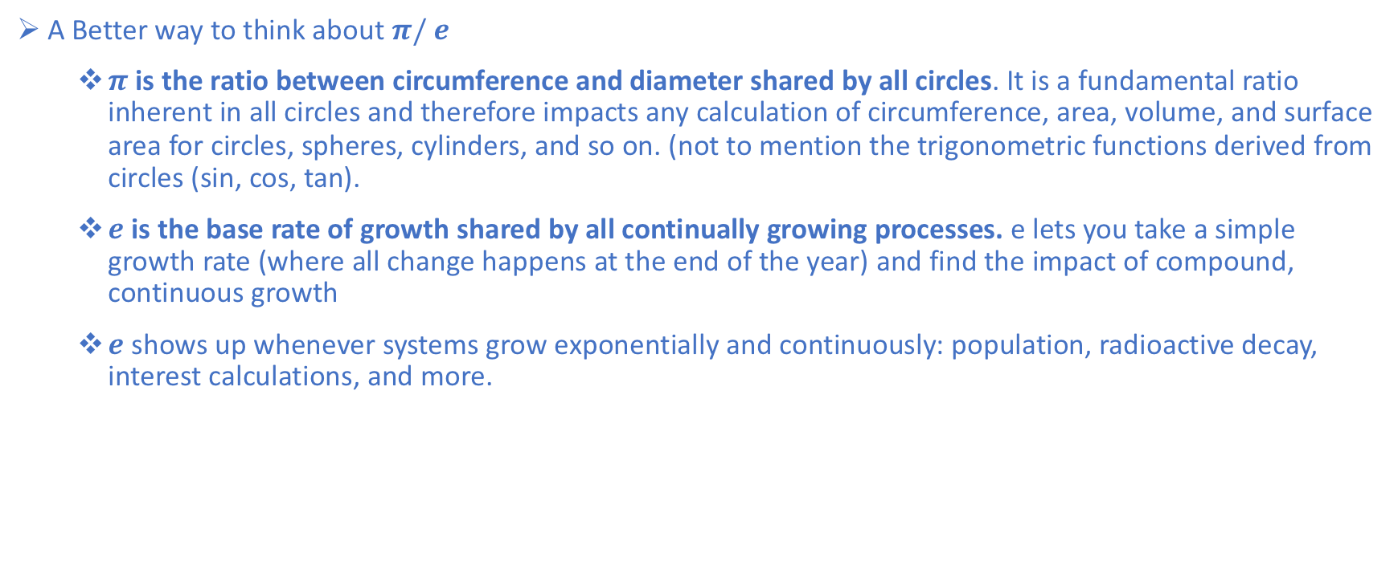
$$e$$
A Better way to think about $π/ e$
$π$ is the ratio between circumference and diameter shared by all circles. It is a fundamental ratio inherent in all circles and therefore impacts any calculation of circumference, area, volume, and surface area for circles, spheres, cylinders, and so on. (not to mention the trigonometric functions derived from circles (sin, cos, tan).
$e$ is the base rate of growth shared by all continually growing processes. e lets you take a simple growth rate (where all change happens at the end of the year) and find the impact of compound, continuous growth
$e$ shows up whenever systems grow exponentially and continuously: population, radioactive decay, interest calculations, and more.

Slide 35
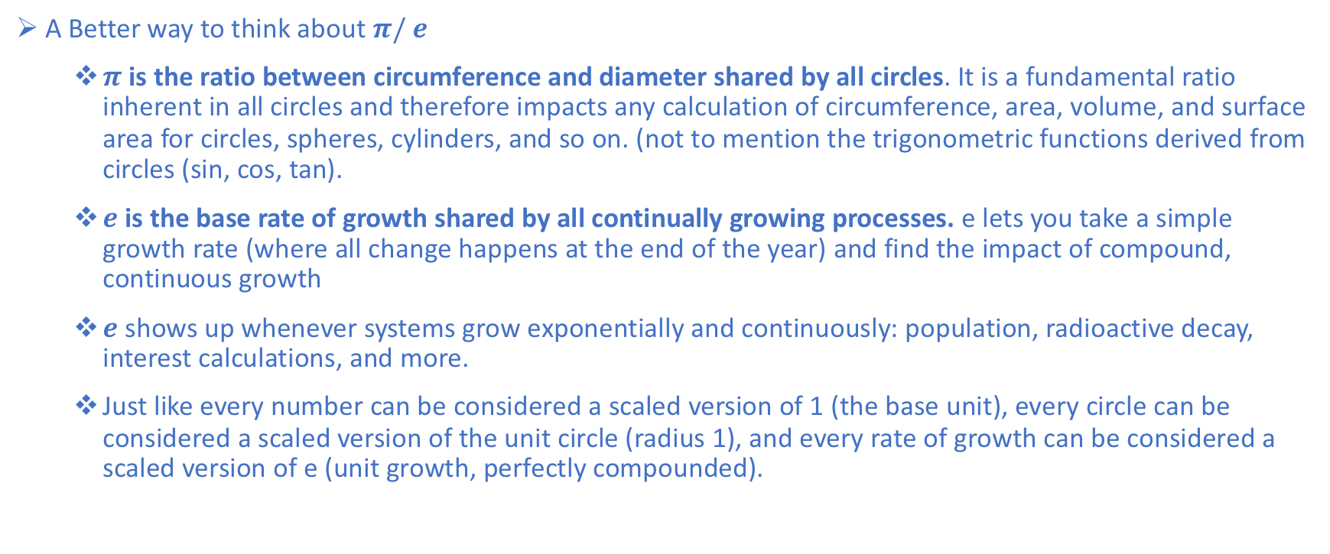
$$e$$
A Better way to think about $π/ e$
$π$ is the ratio between circumference and diameter shared by all circles. It is a fundamental ratio inherent in all circles and therefore impacts any calculation of circumference, area, volume, and surface area for circles, spheres, cylinders, and so on. (not to mention the trigonometric functions derived from circles (sin, cos, tan).
$e$ is the base rate of growth shared by all continually growing processes. e lets you take a simple growth rate (where all change happens at the end of the year) and find the impact of compound, continuous growth
$e$ shows up whenever systems grow exponentially and continuously: population, radioactive decay, interest calculations, and more.
Just like every number can be considered a scaled version of 1 (the base unit), every circle can be considered a scaled version of the unit circle (radius 1), and every rate of growth can be considered a scaled version of e (unit growth, perfectly compounded).

Slide 36
Exponential Growth
Understanding Exponential Growth
Let’s look at a basic system that doubles after an amount of time. For example,
Bacteria can split and “doubles” every 24 hours
We get twice as many noodles when we fold them in half.
Your money doubles every year if you get 100% return

Slide 37
Exponential Growth
Understanding Exponential Growth
Let’s look at a basic system that doubles after an amount of time. For example,
Bacteria can split and “doubles” every 24 hours
We get twice as many noodles when we fold them in half.
Your money doubles every year if you get 100% return
It looks like this:

Slide 38
Exponential Growth
Understanding Exponential Growth
Let’s look at a basic system that doubles after an amount of time. For example,
Bacteria can split and “doubles” every 24 hours
We get twice as many noodles when we fold them in half.
Your money doubles every year if you get 100% return
It looks like this:

Slide 39
The secret to e
The big secret: e merges rate and time
This is wild, e^{x} can mean two things:
x is the number of times we multiply a growth rate: 100% growth for 3 years is e³
x is the growth rate itself: 300% growth for one year is e³

Slide 40
The secret to e
The big secret: e merges rate and time
This is wild, e^{x} can mean two things:
x is the number of times we multiply a growth rate: 100% growth for 3 years is e³
x is the growth rate itself: 300% growth for one year is e³
And now you know why it’s “e”, and not pi or some other number: e raised to “r*t” gives you the growth impact of rate r and time t.

Slide 41
Demystifying the Natural Logarithm (ln)
After understanding the exponential function, the next component required for logistic regression is the natural log
If you look-up the Wikipedia definition, it’s “the inverse of e^x”
e and the Natural Log are twins:
e^x is the amount of continuous growth after a certain amount of time.
Natural Log (ln) is the amount of time needed to reach a certain level of continuous growth

Slide 42
Logistic Regression
When we think of linear regression, we usually think of predicting a numeric quantity
Logistic Regression is somewhat misleading in that it serves primarily as a binary classification model
Categorical response (y) with 2 levels (binary: 0 and 1)
Passing or failing a test
Surviving a plane crash or not
Hospitalisation required or not
Diagnosis of diabetes (yes / no)
Labelling (over/under some threshold)
Predictor variables (x_{i}) can take on any form: binary, categorical, and/or continuous

Slide 43
Logistic Regression Classification
Consider this set of binary data
y
1
0
x

Slide 44
Logistic Regression Classification
Consider this set of binary data
y
1
Passed Exam?
0
x
Hours of Studying

Slide 45
Logistic Regression Classification
Consider this set of binary data
y
1
I could have still passed here
This is usually me
Passed Exam?
0
x
Hours of Studying

Slide 46
Logistic Regression Classification
Consider this set of binary data
y
1
My Roommate in College
Passed Exam?
0
x
We all feel bad for this guy
Hours of Studying

Slide 47
Logistic Regression Classification
Linear Model? – Aside from being binary, there’s nothing special about (y)
y
1
Passed Exam?
0
x
Hours of Studying

Slide 48
Logistic Regression Classification
The value of “Passed Exam” is higher if a student studies more
y
1
Passed Exam?
0
x
Hours of Studying

Slide 49
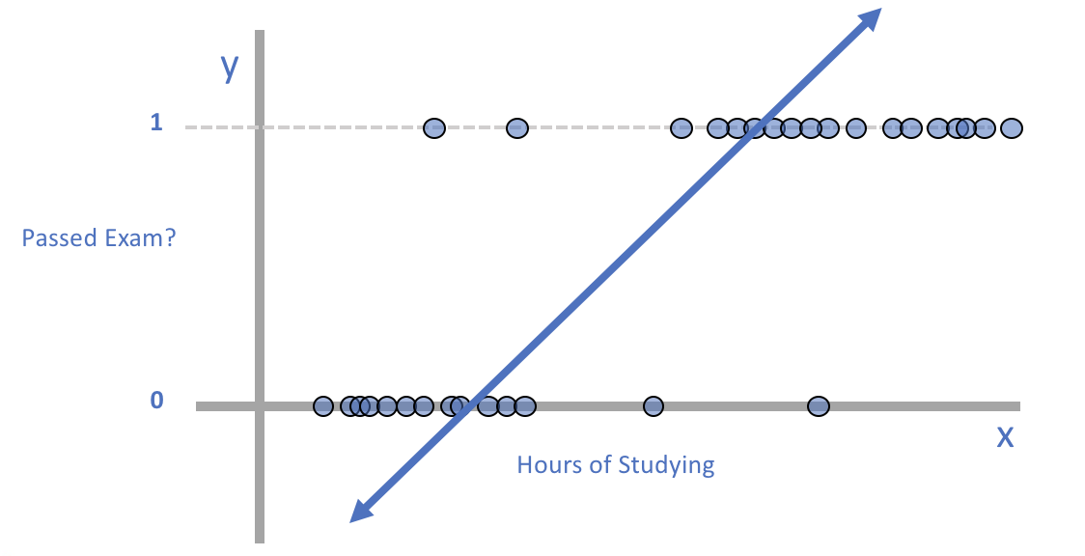
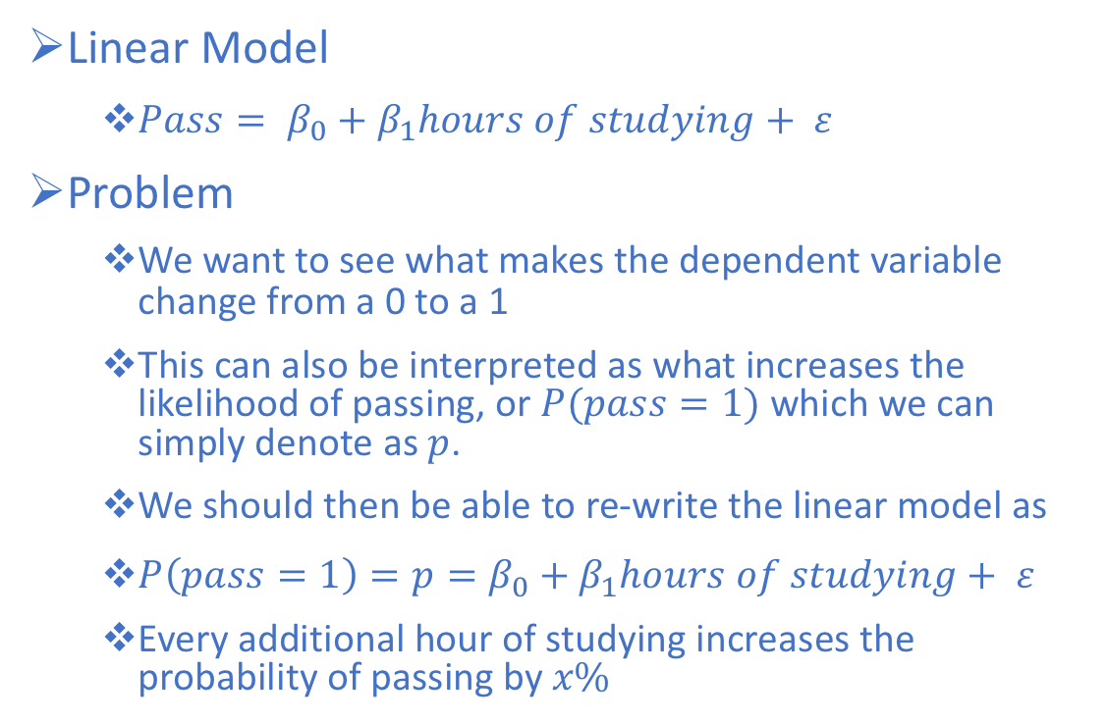
Logistic Regression Classification
Linear Model
$Pass= β_{0}+β_{1}hours of studying+ ε$
Problem
We want to see what makes the dependent variable change from a 0 to a 1
This can also be interpreted as what increases the likelihood of passing, or $P(pass=1)$which we can simply denote as $p$.
We should then be able to re-write the linear model as
$P\left(pass=1\right)=p=β_{0}+β_{1}hours of studying+ ε$
Every additional hour of studying increases the probability of passing by $x\%$

Slide 50
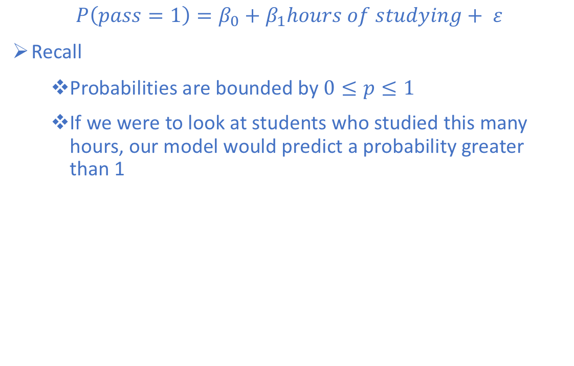
Logistic Regression Classification
$$P\left(pass=1\right)=β_{0}+β_{1}hours of studying+ ε$$
Recall
Probabilities are bounded by $0≤p≤1$
If we were to look at students who studied this many hours, our model would predict a probability greater than 1

Slide 51
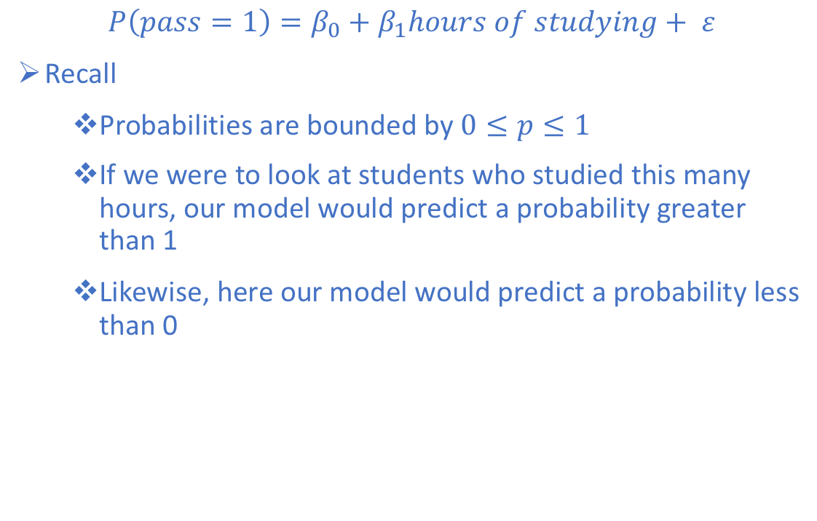
Logistic Regression Classification
$$P\left(pass=1\right)=β_{0}+β_{1}hours of studying+ ε$$
Recall
Probabilities are bounded by $0≤p≤1$
If we were to look at students who studied this many hours, our model would predict a probability greater than 1
Likewise, here our model would predict a probability less than 0

Slide 52
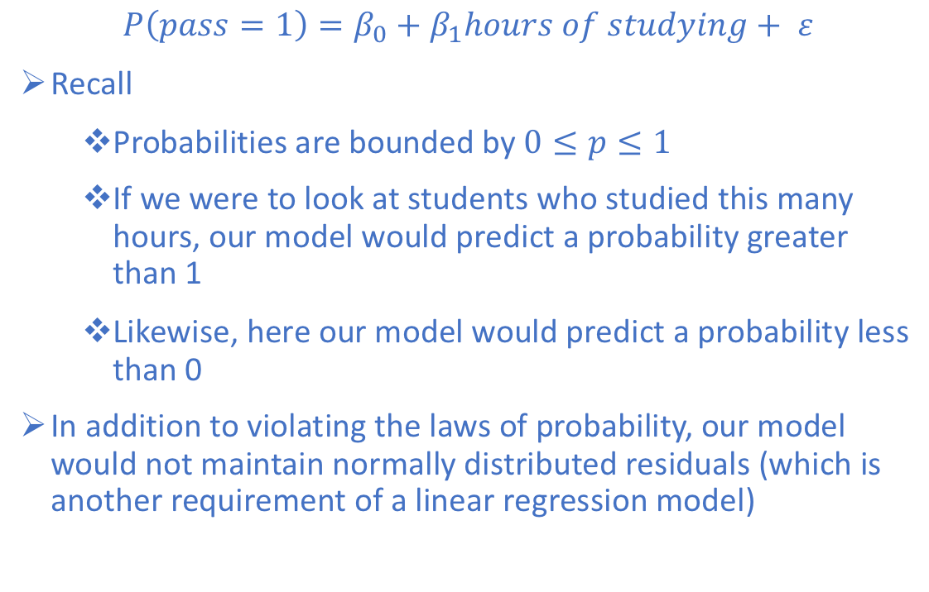
Logistic Regression Classification
$$P\left(pass=1\right)=β_{0}+β_{1}hours of studying+ ε$$
Recall
Probabilities are bounded by $0≤p≤1$
If we were to look at students who studied this many hours, our model would predict a probability greater than 1
Likewise, here our model would predict a probability less than 0
In addition to violating the laws of probability, our model would not maintain normally distributed residuals (which is another requirement of a linear regression model)

Slide 53
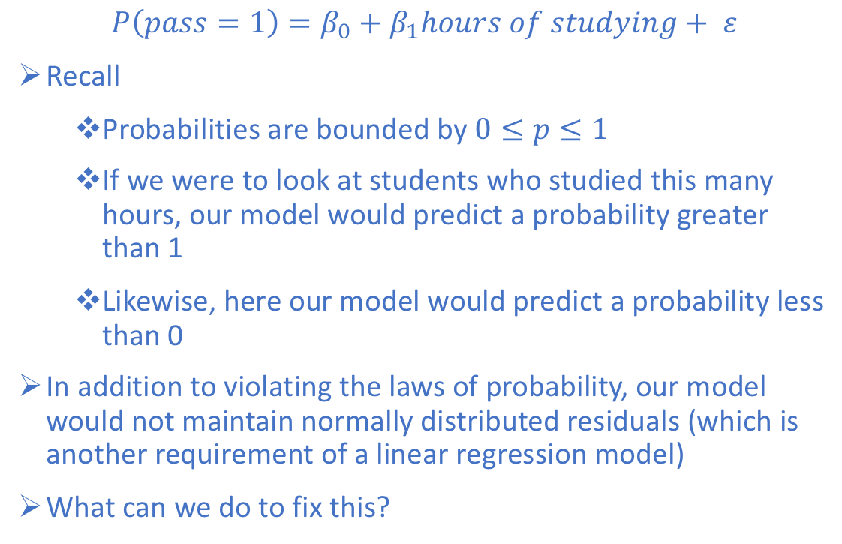
Logistic Regression Classification
$$P\left(pass=1\right)=β_{0}+β_{1}hours of studying+ ε$$
Recall
Probabilities are bounded by $0≤p≤1$
If we were to look at students who studied this many hours, our model would predict a probability greater than 1
Likewise, here our model would predict a probability less than 0
In addition to violating the laws of probability, our model would not maintain normally distributed residuals (which is another requirement of a linear regression model)
What can we do to fix this?

Slide 54
Logistic Regression Classification
We could cap the probabilities at 0 and 1
y
1
Passed Exam?
0
x
Hours of Studying

Slide 55
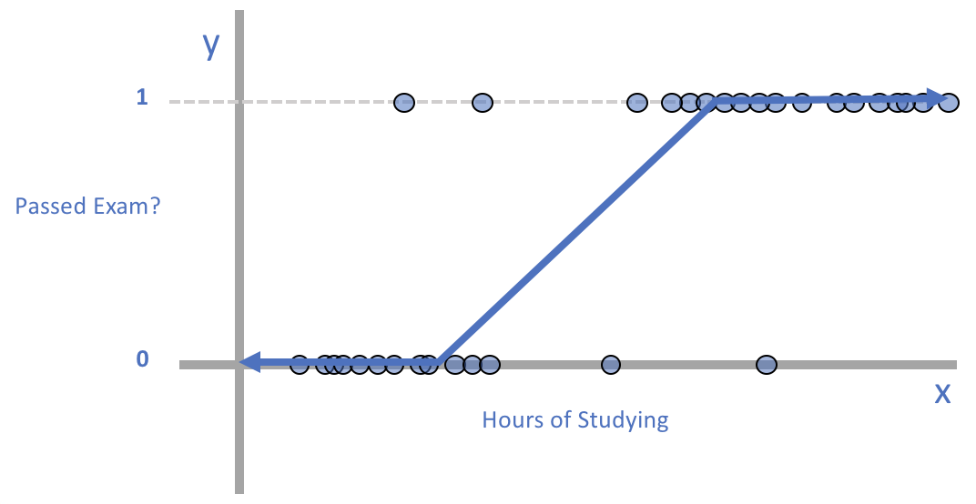
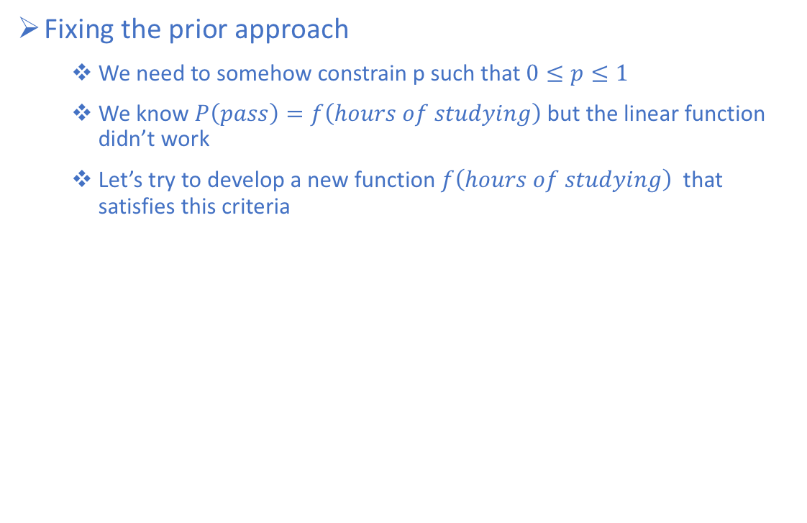
Logistic Regression Classification
Fixing the prior approach
We need to somehow constrain p such that $0≤p≤1$
We know $P\left(pass\right)=f\left(hours of studying\right)$ but the linear function didn’t work
Let’s try to develop a new function $f\left(hours of studying\right)$ that satisfies this criteria

Slide 56
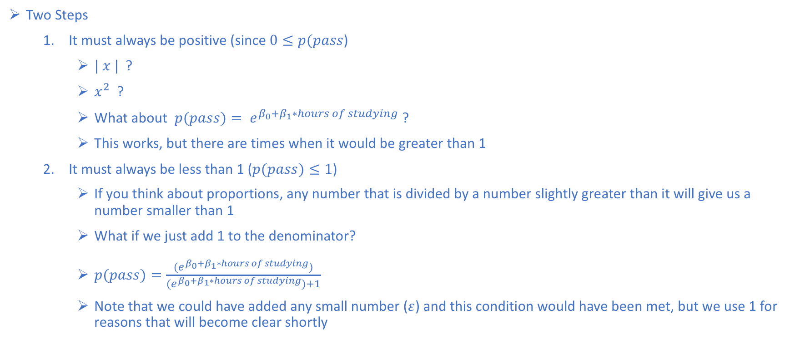
Logistic Regression Classification
Two Steps
It must always be positive (since $0≤p(pass$)
$| x |$?
$x^{2}$ ?
What about $p(pass)= e^{β_{0}+β_{1}∗hours of studying}$ ?
This works, but there are times when it would be greater than 1
It must always be less than 1 ($p(pass)≤1$)
If you think about proportions, any number that is divided by a number slightly greater than it will give us a number smaller than 1
What if we just add 1 to the denominator?
$p(pass)=\frac{(e^{β_{0}+β_{1}∗hours of studying})}{{(e}^{β_{0}+β_{1}∗hours of studying})+1}$
Note that we could have added any small number ($ε$) and this condition would have been met, but we use 1 for reasons that will become clear shortly

Slide 57
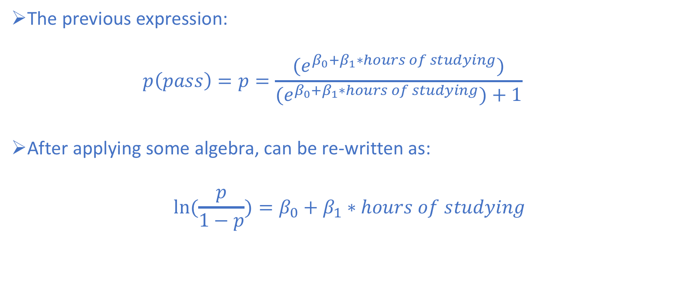
Logistic Regression Classification
The previous expression:
$$p\left(pass\right)=p=\frac{(e^{β_{0}+β_{1}∗hours of studying})}{{(e}^{β_{0}+β_{1}∗hours of studying})+1}$$
After applying some algebra, can be re-written as:
$$ln⁡(\frac{p}{1−p})=β_{0}+β_{1}∗hours of studying$$

Slide 58
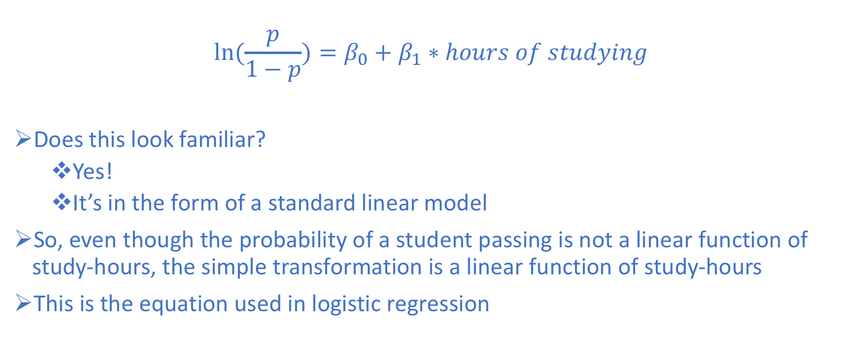
Logistic Regression Classification
$$ln⁡(\frac{p}{1−p})=β_{0}+β_{1}∗hours of studying$$
Does this look familiar?
Yes!
It’s in the form of a standard linear model
So, even though the probability of a student passing is not a linear function of study-hours, the simple transformation is a linear function of study-hours
This is the equation used in logistic regression

Slide 59
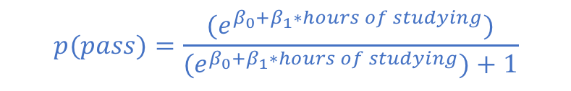
Logistic Regression Classification
Logistic Regression
y
1
$$p(pass)=\frac{(e^{β_{0}+β_{1}∗hours of studying})}{{(e}^{β_{0}+β_{1}∗hours of studying})+1}$$
Passed Exam?
0
x
Hours of Studying

Slide 60
Logistic Regression Classification
Logistic Regression
y
1
Logistic Function
Passed Exam?
0
x
Hours of Studying

Slide 61
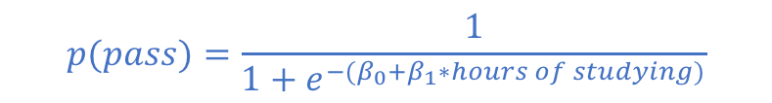
Logistic Regression Classification
Logistic Regression
y
1
$$p(pass)=\frac{1}{1+e^{{−(β}_{0}+β_{1}∗hours of studying)}}$$
Passed Exam?
0
x
Hours of Studying

Slide 62
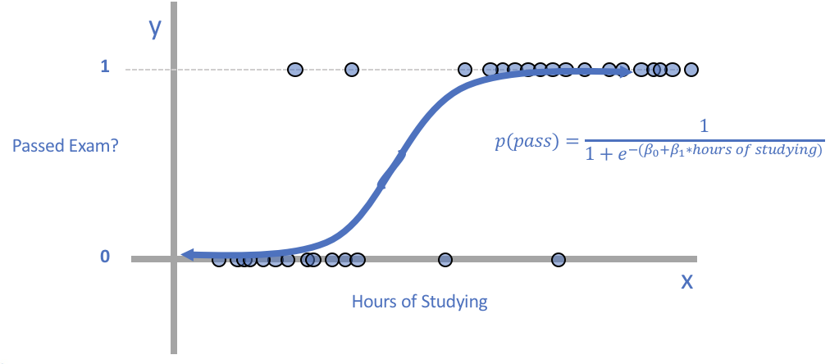
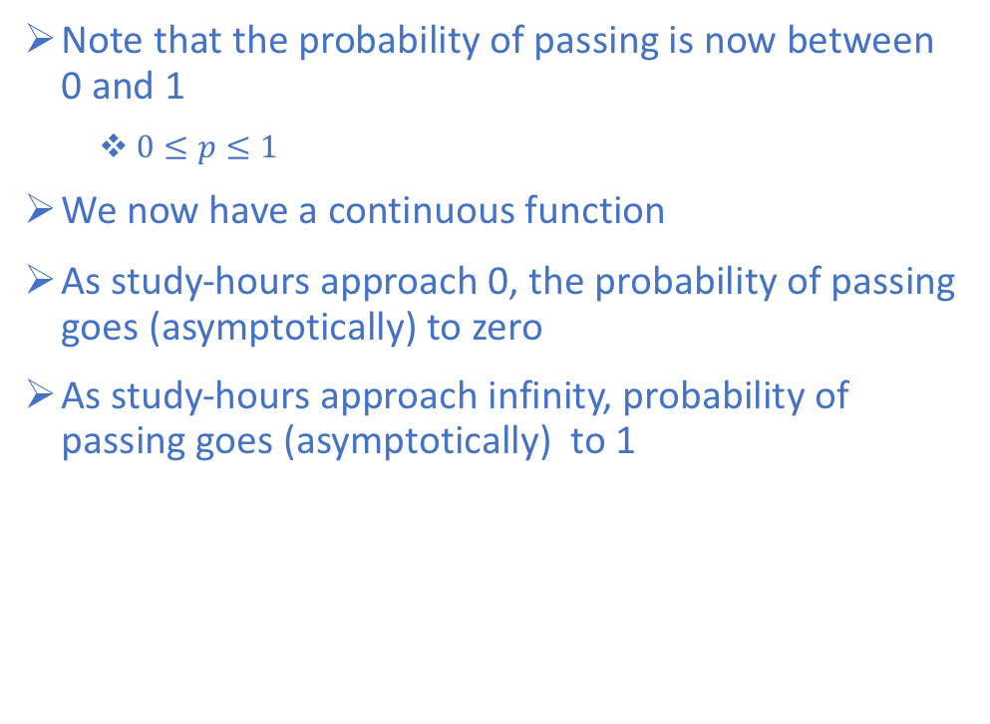
Logistic Regression Classification
Note that the probability of passing is now between 0 and 1
$0≤p≤1$
We now have a continuous function
As study-hours approach 0, the probability of passing goes (asymptotically) to zero
As study-hours approach infinity, probability of passing goes (asymptotically) to 1

Slide 63
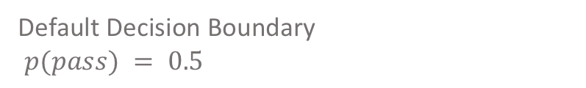
Logistic Regression Classification
Decision Boundary
y
1
Passed Exam?
0.5
Default Decision Boundary
$p(pass) = 0.5$
0
x
Hours of Studying

Slide 64
Logistic Regression Classification
Decision Boundary
y
1
Passed Exam?
0.5
0
x
Hours of Studying

Slide 65
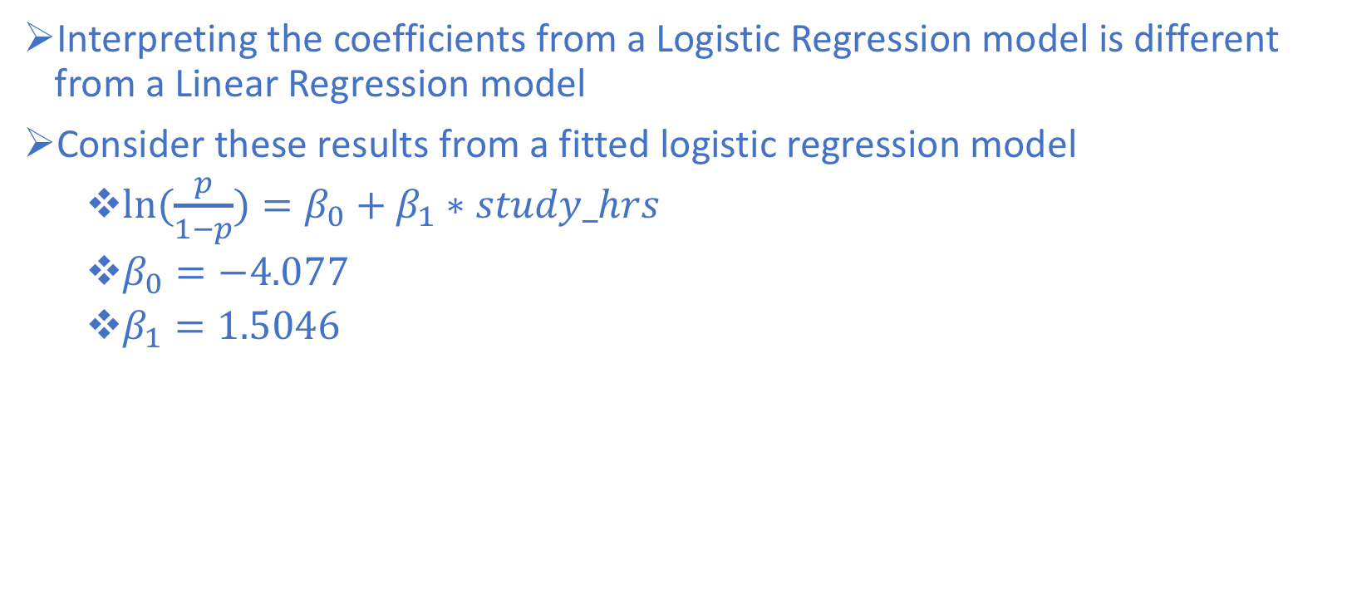
Interpreting Binary Logistic Regression Model Output
Interpreting the coefficients from a Logistic Regression model is different from a Linear Regression model
Consider these results from a fitted logistic regression model
$ln⁡(\frac{p}{1−p})=β_{0}+β_{1}∗study_hrs$
$β_{0}=−4.077$
$β_{1}=1.5046$

Slide 66
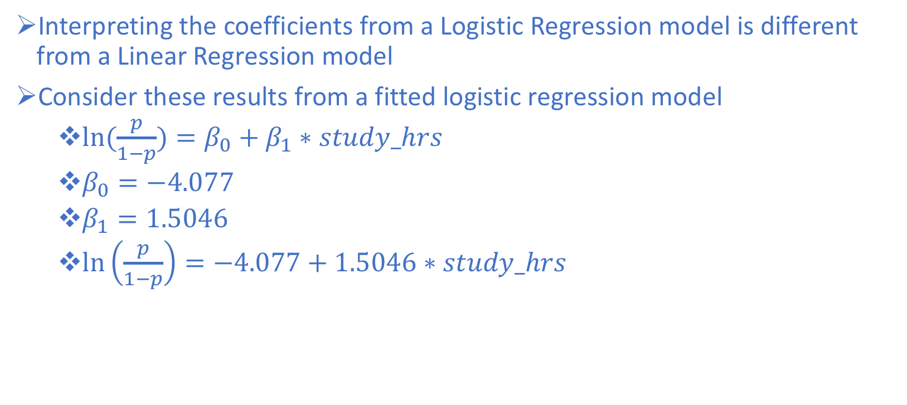
Interpreting Binary Logistic Regression Model Output
Interpreting the coefficients from a Logistic Regression model is different from a Linear Regression model
Consider these results from a fitted logistic regression model
$ln⁡(\frac{p}{1−p})=β_{0}+β_{1}∗study_hrs$
$β_{0}=−4.077$
$β_{1}=1.5046$
$\ln\left(\frac{p}{1−p}\right)=−4.077+1.5046∗study_hrs$

Slide 67
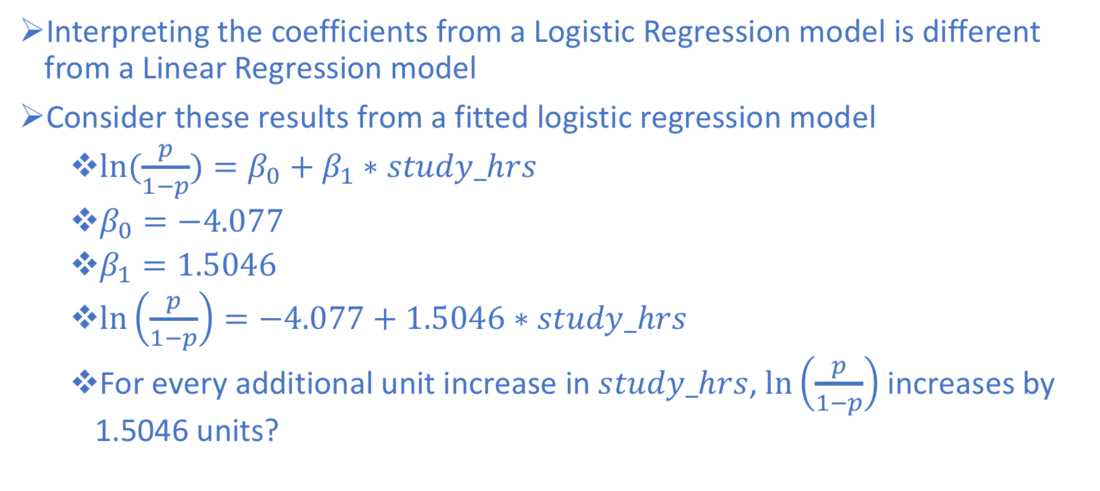
Interpreting Binary Logistic Regression Model Output
Interpreting the coefficients from a Logistic Regression model is different from a Linear Regression model
Consider these results from a fitted logistic regression model
$ln⁡(\frac{p}{1−p})=β_{0}+β_{1}∗study_hrs$
$β_{0}=−4.077$
$β_{1}=1.5046$
$\ln\left(\frac{p}{1−p}\right)=−4.077+1.5046∗study_hrs$
For every additional unit increase in $study_hrs$, $\ln\left(\frac{p}{1−p}\right)$ increases by 1.5046 units?

Slide 68
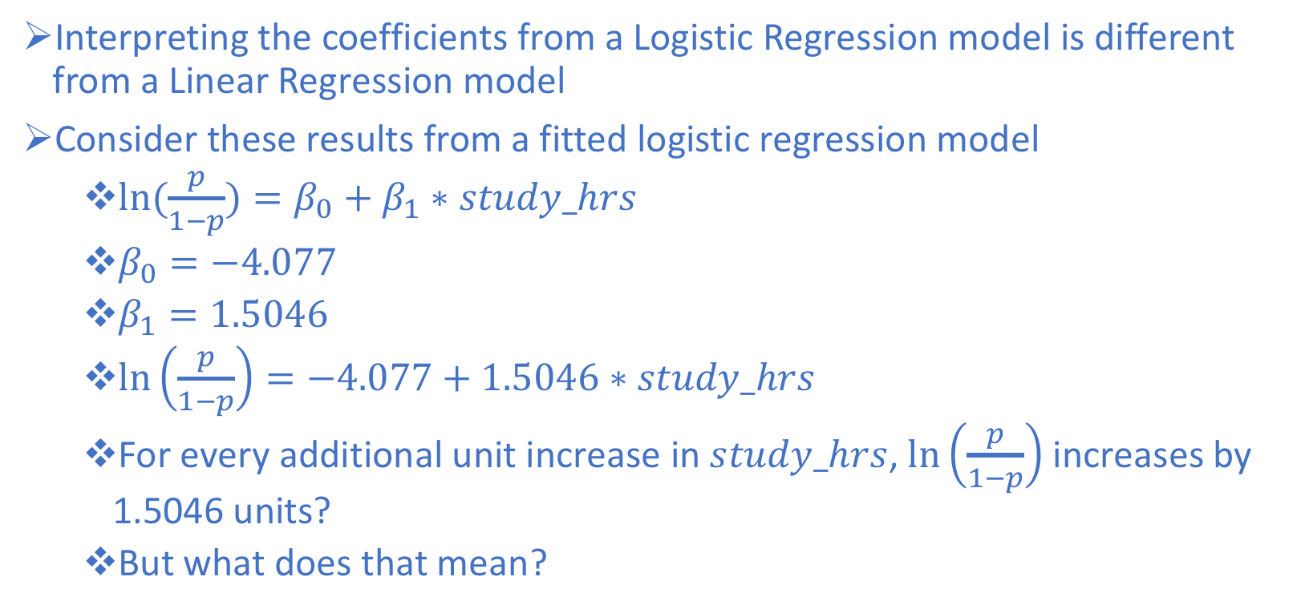
Interpreting Binary Logistic Regression Model Output
Interpreting the coefficients from a Logistic Regression model is different from a Linear Regression model
Consider these results from a fitted logistic regression model
$ln⁡(\frac{p}{1−p})=β_{0}+β_{1}∗study_hrs$
$β_{0}=−4.077$
$β_{1}=1.5046$
$\ln\left(\frac{p}{1−p}\right)=−4.077+1.5046∗study_hrs$
For every additional unit increase in $study_hrs$, $\ln\left(\frac{p}{1−p}\right)$ increases by 1.5046 units?
But what does that mean?

Slide 69
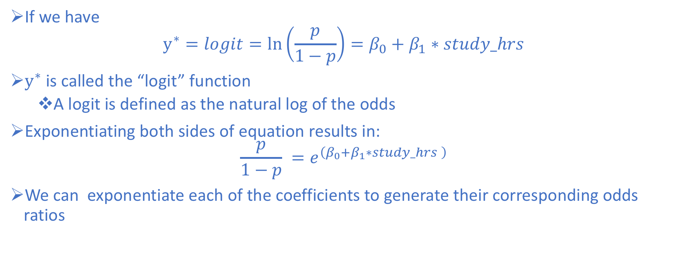
Interpreting Binary Logistic Regression Model Output
If we have
$$y^{∗}=logit=\ln\left(\frac{p}{1−p}\right)=β_{0}+β_{1}∗study_hrs$$
$y^{∗}$ is called the “logit” function
A logit is defined as the natural log of the odds
Exponentiating both sides of equation results in:
$$\frac{p}{1−p} =e^{\left(β_{0}+β_{1}∗study_hrs \right)}$$
We can exponentiate each of the coefficients to generate their corresponding odds ratios

Slide 70
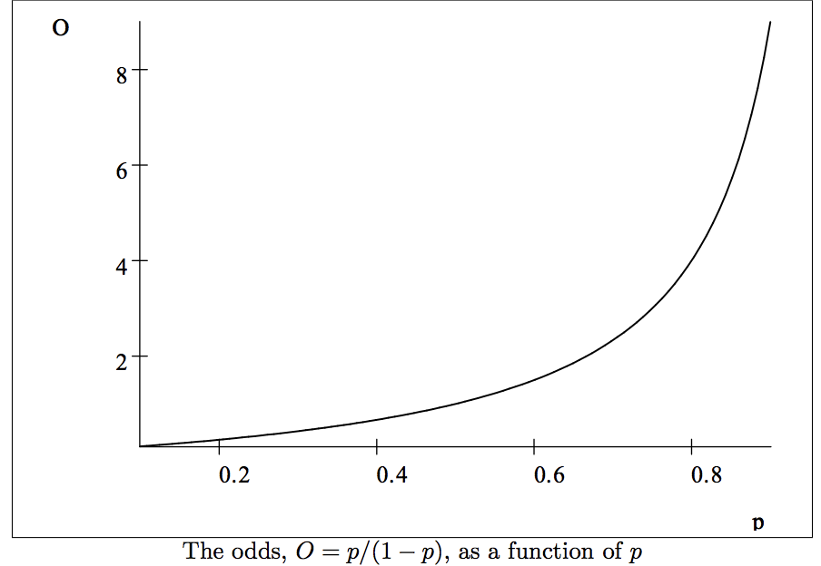
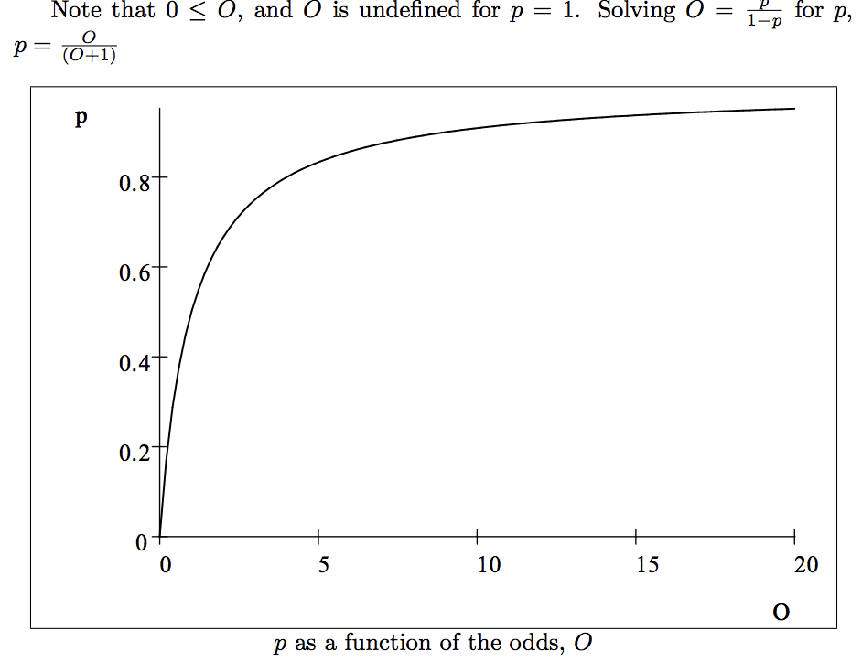
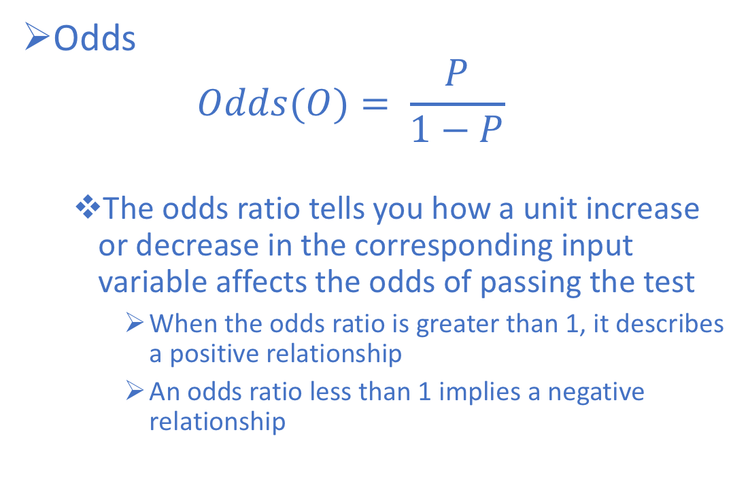
Interpreting Binary Logistic Regression Model Output
Odds
$$Odds(O)= \frac{P}{1−P}$$
The odds ratio tells you how a unit increase or decrease in the corresponding input variable affects the odds of passing the test
When the odds ratio is greater than 1, it describes a positive relationship
An odds ratio less than 1 implies a negative relationship

Slide 71
Logistic Regression Classification
Visualizing the Logistic Regression Model
y
1
Passed Exam?
0.5
0.122
0
1.4
x
Hours of Studying

Slide 72
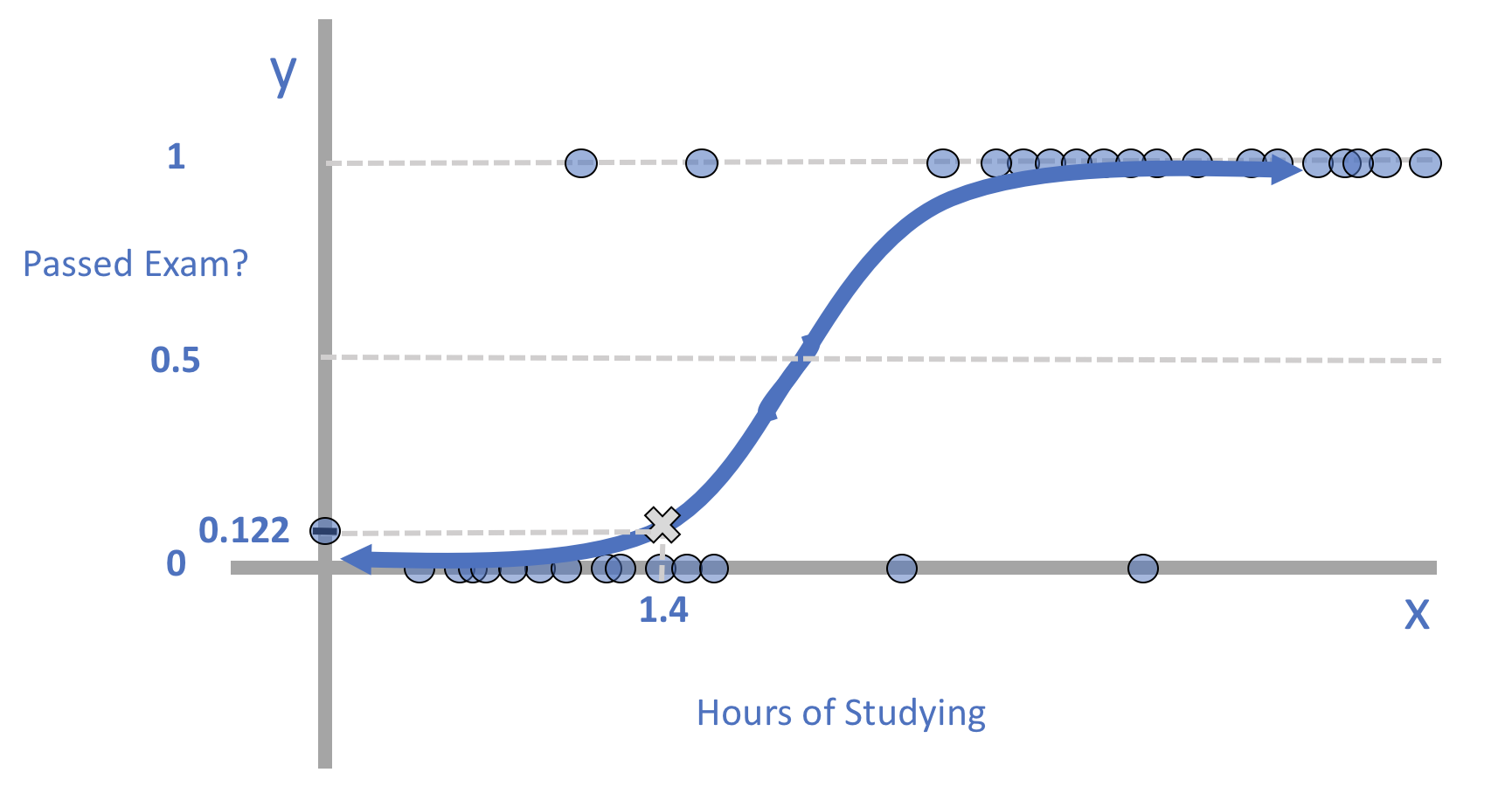
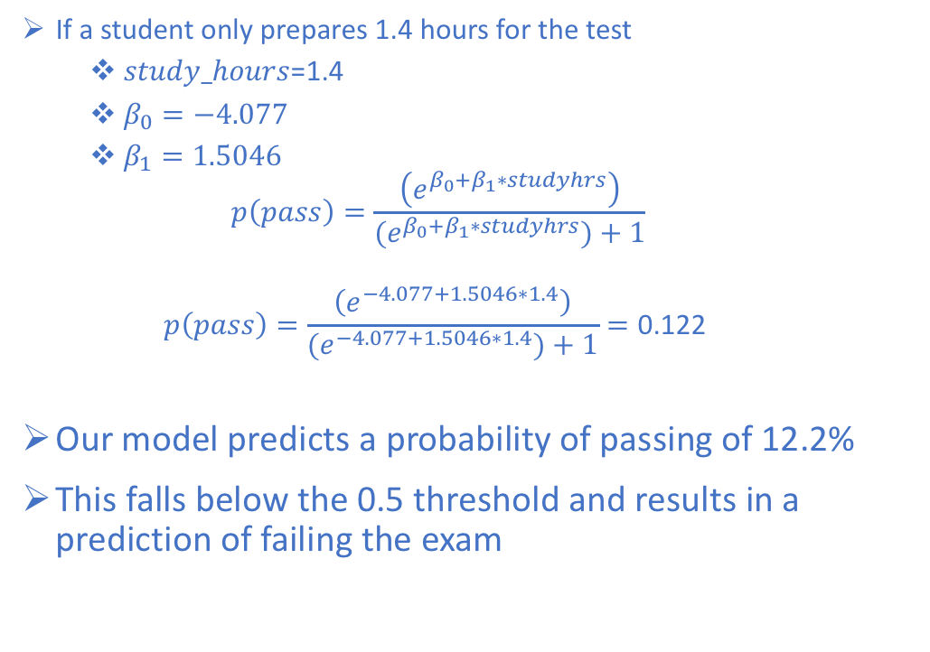
Logistic Regression Classification
If a student only prepares 1.4 hours for the test
$study_hours$=1.4
$β_{0}=−4.077$
$β_{1}=1.5046$
$$p\left(pass\right)=\frac{\left(e^{β_{0}+β_{1}∗studyhrs}\right)}{{(e}^{β_{0}+β_{1}∗studyhrs})+1}$$
$$p\left(pass\right)=\frac{\left(e^{−4.077+1.5046∗1.4}\right)}{{(e}^{−4.077+1.5046∗1.4})+1}=\text{0.1}\text{22}$$
Our model predicts a probability of passing of 12.2%
This falls below the 0.5 threshold and results in a prediction of failing the exam

Slide 73
Logistic Regression Example

Slide 74
References
Locally Weighted Learning by Atkeson, Moore, Schaal
Tuning Locally Weighted Learning by Schaal, Atkeson, Moore
Kruschke, J. K. (2014). Doing Bayesian Data Analysis: A Tutorial with R, JAGS, and Stan. 2nd Edition.
Machine Learning, Neural and Statistical Classification, Editors: D. Michie, D.J. Spiegelhalter, C.C. Taylor
http://www.dataschool.io/guide-to-logistic-regression/

